Slide 1
Java Collections

Slide 2
Java Collections:
Any group of individual objects that are represented as a single unit is known as a Java Collection of Objects.
In Java, a separate framework named the “Collection Framework” has been defined in JDK 1.2 which holds all the Java Collection Classes and Interface in it.
In Java, the Collection interface (java.util.Collection) and Map interface (java.util.Map) are the two main “root” interfaces of Java collection classes.
Collections in Java is a framework that stores and manipulates a group of objects. It is a hierarchy of interfaces and classes that provides easy management of a group of objects. Java Collection framework provides many interfaces (List, Queue, Deque, Set) and classes (ArrayList, Vector, LinkedList, PriorityQueue, HashSet, LinkedHashSet, TreeSet).

Slide 3
What is a Collection in Java?
Consider the example of a piggy bank. We all had it during our childhood where we used to store our coins. This piggy bank is called a Collection and the coins are nothing but objects. Technically, a collection is an object or a container that stores a group of other objects.
A Collection in Java is an object which represents a group of objects, known as its elements. It is a single unit. They are used to standardize the way in which objects are handled in the class.
Now that we know what Collection in Java is, let us try to understand the real-life use cases:
Linked list emulates your browsing history, trains coaches who are connected to each other, etc
Stacks are like a stack of plates or trays in which the topmost one gets picked first.
Queue is the same as the real-life queues, the one who enters the queue first, leaves it first too.

Slide 4
What is Java Collections Framework?
The Collections Framework is defined as a unified architecture for representing and manipulating collections. In Java, the Collections Framework is a hierarchy of interfaces and classes that provides easy management of a group of objects.
The java.util package contains the powerful tool of Collections Framework. It was defined in JDK 1.2 version which is one of the most used frameworks to date.
It provides a ready-made architecture for interfaces and classes and is used for storing and manipulating a group of objects. All collections frameworks contain interfaces, classes, and algorithms.
Now you might be wondering what is its need. Collections in Java were not a part of the original Java release. But prior to the release, Vectors, Stacks, and Arrays were there. They had one major disadvantage, and that was lesser similarities. They didn't have a common interface and interconnection with each other.

Slide 5
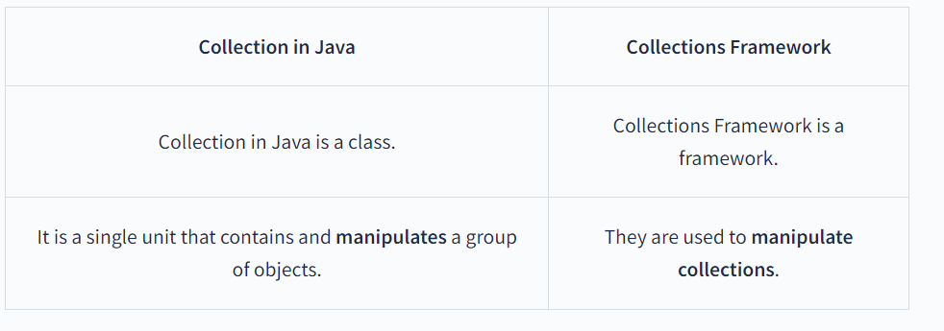
Java Collection vs Collections Framework :

Slide 6
Advantages of Java Collections Framework :
As mentioned above, the Collections Framework in Java carries a lot of advantages.
Provides high-performance and high efficiency. This is due to the fact that various implementations of each interface are interchangeable, so programs can be written by switching implementations.
Some methods of each interface of the Collections Framework have a uniform implementation. The Collections API has basic interfaces like Set, Map, and List, so the classes that implement them have a few common sets of methods.
Reduces the programming effort by providing useful data structures and algorithms. We don't have to write our own data structure as it has already been provided to us.
Facilitates code reusability. Collections Framework provides common classes and interfaces that can be used with different types of collections.

Slide 7
Hierarchy of Collections Framework:
The Collections Framework in Java follows a certain hierarchy. All the classes and interfaces in the Collections Framework come under the java.util package.
But before getting acquainted with the hierarchy of the Collections Framework in Java, Let us understand these terms.
Class: A class is a collection of similar types of objects. It is an implementation of the collection interface.
Interface: An interface is the abstract data type. It is at the topmost position in the framework hierarchy. In Layman's terms, it is a group of related methods with empty bodies. Abstraction is a process of hiding the implementation details from the user by only providing the functionality. Using interfaces, we can achieve (complete) abstraction.
extends: It is a keyword that is used to develop inheritance between two classes and two interfaces. Inheritance in Java refers to the concept that one can create new classes that are built upon existing classes.
implements: implements is also a keyword used to develop inheritance between class and interface. A class implements an interface.

Slide 8
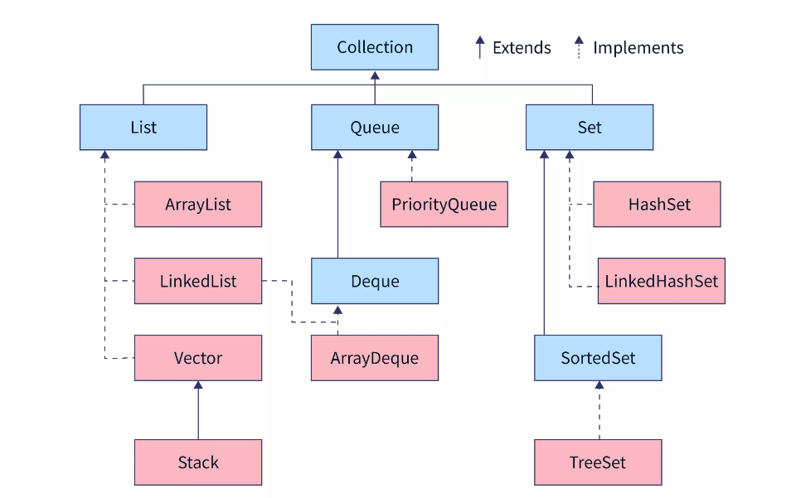

Slide 9
It consists of four core interfaces such as Collection, List, Set, Queue, and various classes which get implemented through them.
Collection Interface :
The Collection Interface is the root or the foundation on which the Collections Framework is built. It is a general interface that has the declaration:
interface Collection<E>
Here, E is the type of object that the collection will hold.
It provides basic operations like adding, removing, clearing the elements in a collection, checking whether the collection is empty, etc.
List, Queue and Set are the components that extend the Collection Interface.
Methods of the Collection Interface:
The Collection Interface has the following methods. The methods declared in an interface are by default abstract (only method signature, no body of the method).

Slide 10
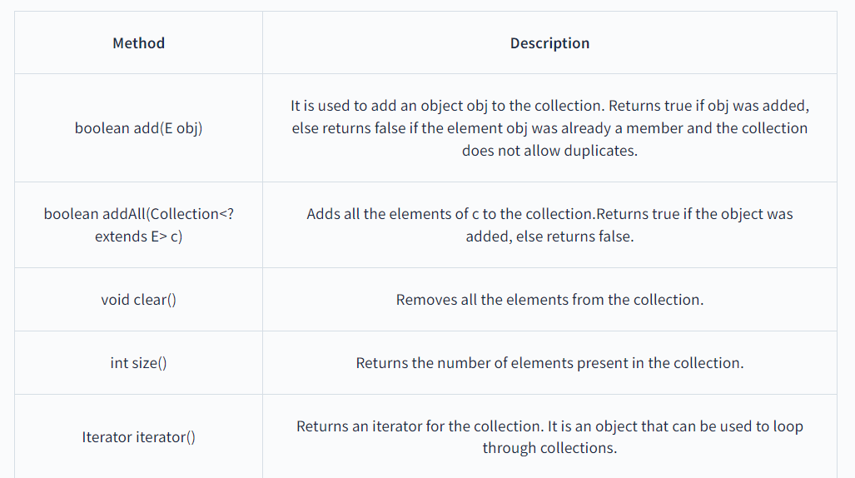
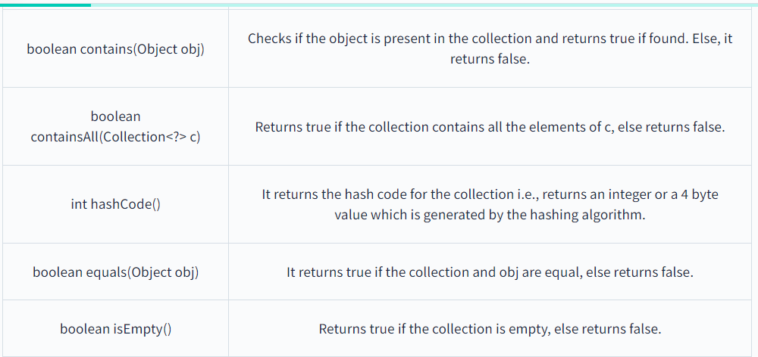

Slide 11
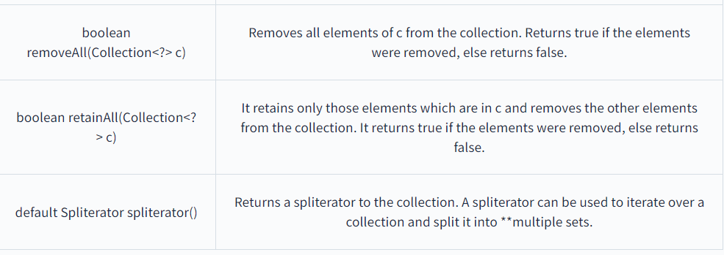

Slide 12
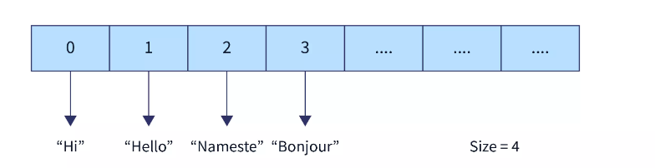
1. ArrayList :
So, you must've figured it out from the name itself, that ArrayList is similar to Arrays. They are also called dynamic arrays. That means it does not have a fixed size. Its size can be increased or decreased if elements are added or removed.
It implements the List Interface.
Since the ArrayList cannot be used for primitive data types like int, char, etc. , we need to use a wrapper class.

Slide 13
In order to initialize an ArrayList, there are 3 ways.
Using the add Keyword
ArrayList<Data-Type> str = new ArrayList<Data-Type>();
str.add(<content>);
str.add(<content>);
str.add(<content>);
Example :
//initialising ArrayList using add keyword
import java.util.*;
public class ScalerTopics {
public static void main(String args[])
{
// create an ArrayList of String type
ArrayList<String> str = new ArrayList<String>();
// Initialize an ArrayList with add()
str.add("Scaler");
str.add("Topics");
str.add("Rocks");
// to print the ArrayList
System.out.println("ArrayList is" + str);
}
}

Slide 14
2. Using asList() AsList() method in Java is used to return a fixed-size list backed by the given array.
ArrayList<Data-Type> obj =
new ArrayList<Data-Type(Arrays.asList(Obj A, Obj B, Obj C, ....));
Example :
// initialise ArrayList using asList method
import java.util.*;
public class ScalerTopics {
public static void main(String args[])
{
// create an ArrayList of String type
// and Initialize an ArrayList with asList()
ArrayList<String> scaler = new ArrayList<String>(
Arrays.asList("I",
"love",
"Java"));
// to print the ArrayList
System.out.println("ArrayList is " + scaler);
}
}

Slide 15
3. Using list.of() Method It is used to return immutable lists containing the specified elements.
List<Data-Type> obj = new ArrayList<>(
List.of(Obj 1, Obj 1, Obj 1, ....));
Example :
// initialise ArrayList using List.of() method
import java.util.*;
public class ScalerTopics {
public static void main(String args[])
{
// create an ArrayList of String type
// and Initialize an ArrayList with List.of()
List<String> str = new ArrayList<>(
List.of("Coding",
"is",
"Fun"));
// to print the ArrayList
System.out.println("ArrayList is " + str);
}
}

Slide 16
Example :
import java.util.*;
public class ScalerTopics{
public static void main(String args[]){
//creating an ArrayList
ArrayList<String> str= new ArrayList<String>();
//displaying the initial size
System.out.println("Size at the beginning "+str.size());
//add elements
str.add("Hello");
str.add("Hi");
str.add("Namaste");
str.add("Bonjour");
//displaying the ArrayList
System.out.println(str);

Slide 17
//displaying the size
System.out.println("Size after addition "+str.size());
//remove element at index 0
str.remove(0);
//display the new ArrayList
System.out.println(str);
//display the new size
System.out.println("Size after removal "+str.size());
}
}

Slide 18
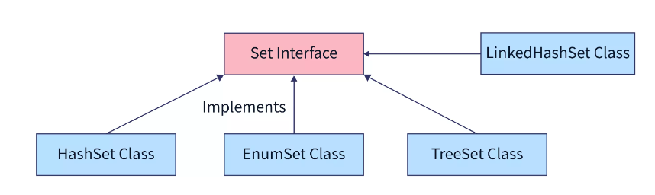
Set Interface:
The Set interface defines an unordered collection.
It extends the Collection Interface.
We cannot store duplicate values in this.
The Set Interface is implemented by popular classes like HashedSet, LinkedHashSet, and TreeSet.

Slide 19
Method to instantiate the Set Interface :
Syntax :
Set<Data-Type> hs = new HashSet<Data-Type>();
Set<Data-Type> lhs = new LinkedHashSet<Data-Type>();
Set<Data-Type> ts = new TreeSet<Data-Type>();

Slide 20
HashSet :
The HashSet class implements the Set Interface.
It uses a hash table for storage which uses a mechanism called Hashing.
In hashing, the informational content of a key determines a unique value, called its hash code.
The hash code is then used as an index, at which the data associated with the key is stored.
When we insert elements into the HashSet, it is not guaranteed that it gets stored in the same order.
We can store Null values in this.
HashSet is non-synchronized means multiple threads at a time can access the code. This means if one thread is working on HashSet, other threads can also get a hold of it. Multiple operations on HashSet can be performed at a time.
For example, if addition is being performed by one thread, other operation can be performed by some other thread too.

Slide 21
Methods to create the constructors of HashSet :
Creating an empty HashSet It is used to create an empty HashSet object in which the default initial capacity is 16.
HashSet<Data-type> hs = new HashSet<Data-type>();
2. Creating a HashSet with a specified size It is used to create a HashSet with the given size.
HashSet<Data-type> hs = new HashSet<Data-type>(int size);
3. Creating a HashSet with a specified size and fill ratio It is used to create a HashSet with a given size and fill ratio.
HashSet<Data-type> hs = new HashSet<Data-type>(int size,float fillRatio);
4. Creating a HashSet from Collection It is used to create a HashSet which contains all the elements from the collection.
HashSet<Data-type> hs = new HashSet<Data-type>(Collection C);

Slide 22
import java.util.*;
public class ScalerTopics{
public static void main(String args[]){
//creating a HashSet
HashSet<String> str= new HashSet<String>();
//displaying the initial size
System.out.println("Size at the beginning "+str.size());
//add elements
str.add("Hello");
str.add("Hi");
str.add("Namaste");
str.add("Bonjour");
//displaying the HashSet
System.out.println(str);
//displaying the size
System.out.println("Size after addition "+str.size());
//remove element using value
str.remove("Bonjour");
//display the new HashSet
System.out.println(str);
//display the new size
System.out.println("Size after removal "+str.size());
}
}

Slide 23
Map Interface:
In Java, Map Interface is present in java.util package represents a mapping between a key and a value.
Java Map interface is not a subtype of the Collection interface. Therefore it behaves a bit differently from the rest of the collection types.
Maps are perfect to use for key-value association mapping such as dictionaries. The maps are used to perform lookups by keys or when someone wants to retrieve and update elements by keys. Some common scenarios are as follows:
A map of error codes and their descriptions.
A map of zip codes and cities.
A map of managers and employees. Each manager (key) is associated with a list of employees (value) he manages.
A map of classes and students. Each class (key) is associated with a list of students (value).

Slide 24
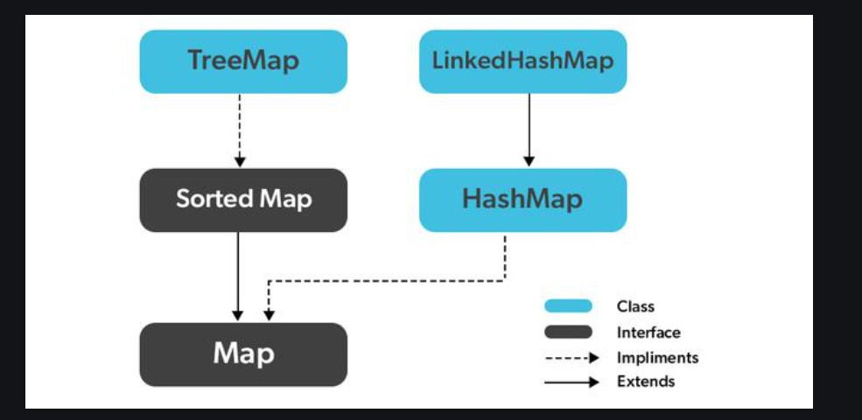

Slide 25
Creating Map Objects:
Since Map is an interface, objects cannot be created of the type map. We always need a class that extends this map in order to create an object. And also, after the introduction of Generics in Java 1.5, it is possible to restrict the type of object that can be stored in the Map.
Syntax: Defining Type-safe Map
Map hm = new HashMap();
// Obj is the type of the object to be stored in Map

Slide 26
// Java Program to Demonstrate
// Working of Map interface
// Importing required classes
import java.util.*;
// Main class
class GFG {
// Main driver method
public static void main(String args[])
{
// Creating an empty HashMap
Map<String, Integer> hm
= new HashMap<String, Integer>();
// Inserting pairs in above Map
// using put() method
hm.put("a", new Integer(100));
hm.put("b", new Integer(200));
hm.put("c", new Integer(300));
hm.put("d", new Integer(400));
// Traversing through Map using for-each loop
for (Map.Entry<String, Integer> me :
hm.entrySet()) {
// Printing keys
System.out.print(me.getKey() + ":");
System.out.println(me.getValue());
}
}
}

Slide 27
HashMap :
HashMap is a part of Java’s collection since Java 1.2. It provides the basic implementation of the Map interface of Java.
It stores the data in (Key, Value) pairs. To access a value one must know its key.
This class uses a technique called Hashing. Hashing is a technique of converting a large String to a small String that represents the same String.
A shorter value helps in indexing and faster searches. Let’s see how to create a map object using this class.

Slide 28
// Java Program to illustrate the Hashmap Class
// Importing required classes
import java.util.*;
// Main class
public class GFG {
// Main driver method
public static void main(String[] args)
{
// Creating an empty HashMap
Map<String, Integer> map = new HashMap<>();
// Inserting entries in the Map
// using put() method
map.put("vishal", 10);
map.put("sachin", 30);
map.put("vaibhav", 20);
// Iterating over Map
for (Map.Entry<String, Integer> e : map.entrySet())
// Printing key-value pairs
System.out.println(e.getKey() + " “ + e.getValue());
}
}

Slide 29
Java Iterator :
An Iterator is an object that can be used to loop through collections, like ArrayList and HashSet. It is called an "iterator" because "iterating" is the technical term for looping.
To use an Iterator, you must import it from the java.util package.
Getting an Iterator() :
The iterator() method can be used to get an Iterator for any collection:

Slide 30
// Import the ArrayList class and the Iterator class
import java.util.ArrayList;
import java.util.Iterator;
public class Main {
public static void main(String[] args) {
// Make a collection
ArrayList<String> cars = new ArrayList<String>();
cars.add("Volvo");
cars.add("BMW");
cars.add("Ford");
cars.add("Mazda");
// Get the iterator
Iterator<String> it = cars.iterator();
// Print the first item
System.out.println(it.next());
}
}

Slide 31
Looping Through a Collection :
To loop through a collection, use the hasNext() and next() methods of the Iterator:
Syntax :
while(it.hasNext()) {
System.out.println(it.next());
}
Removing Items from a Collection:
Iterators are designed to easily change the collections that they loop through. The remove() method can remove items from a collection while looping.

Slide 32
import java.util.ArrayList;
import java.util.Iterator;
public class Main {
public static void main(String[] args) {
ArrayList<Integer> numbers = new ArrayList<Integer>();
numbers.add(12);
numbers.add(8);
numbers.add(2);
numbers.add(23);
Iterator<Integer> it = numbers.iterator();
while(it.hasNext()) {
Integer i = it.next();
if(i < 10) {
it.remove();
}
}
System.out.println(numbers);
}
}
Note: Trying to remove items using a for loop or a for-each loop would not work correctly because the collection is changing size at the same time that the code is trying to loop.

Slide 33
Autoboxing and Unboxing:
The automatic conversion of primitive data types into its equivalent Wrapper type is known as boxing and opposite operation is known as unboxing. This is the new feature of Java5. So java programmer doesn't need to write the conversion code.
Advantage of Autoboxing and Unboxing:
No need of conversion between primitives and Wrappers manually so less coding is required.
Simple Example of Autoboxing in java:
class BoxingExample1{
public static void main(String args[]){
int a=50;
Integer a2=new Integer(a);//Boxing
Integer a3=5;//Boxing
System.out.println(a2+" "+a3);
}
}

Slide 34
Simple Example of Unboxing in java:
The automatic conversion of wrapper class type into corresponding primitive type, is known as Unboxing. Let's see the example of unboxing:
Example :
class UnboxingExample1{
public static void main(String args[]){
Integer i=new Integer(50);
int a=i;
System.out.println(a);
}
}

Slide 35
Java JDBC Tutorial:
JDBC stands for Java Database Connectivity. JDBC is a Java API to connect and execute the query with the database. It is a part of JavaSE (Java Standard Edition).
JDBC API uses JDBC drivers to connect with the database.
There are four types of JDBC drivers:
JDBC-ODBC Bridge Driver,
Native Driver,
Network Protocol Driver, and
Thin Driver

Slide 36
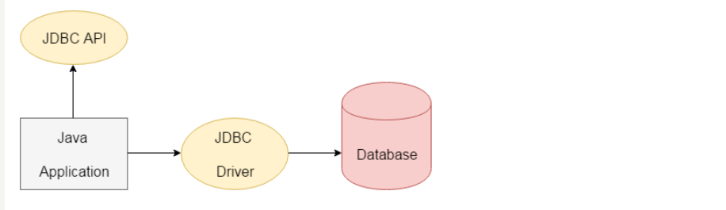
JDBC :

Slide 37
We can use JDBC API to access tabular data stored in any relational database. By the help of JDBC API, we can save, update, delete and fetch data from the database. It is like Open Database Connectivity (ODBC) provided by Microsoft.
The current version of JDBC is 4.3. It is the stable release since 21st September, 2017. It is based on the X/Open SQL Call Level Interface. The java.sql package contains classes and interfaces for JDBC API
Driver interface
Connection interface
Statement interface
PreparedStatement interface
CallableStatement interface
ResultSet interface
ResultSetMetaData interface
DatabaseMetaData interface
RowSet interface

Slide 38
A list of popular classes of JDBC API are given below:
DriverManager class
Blob class
Clob class
Types class
Why Should We Use JDBC:
Before JDBC, ODBC API was the database API to connect and execute the query with the database. But, ODBC API uses ODBC driver which is written in C language (i.e. platform dependent and unsecured). That is why Java has defined its own API (JDBC API) that uses JDBC drivers (written in Java language).
We can use JDBC API to handle database using Java program and can perform the following activities:
Connect to the database
Execute queries and update statements to the database
Retrieve the result received from the database.

Slide 39
What is API :
API (Application programming interface) is a document that contains a description of all the features of a product or software. It represents classes and interfaces that software programs can follow to communicate with each other. An API can be created for applications, libraries, operating systems, etc.
What is Driver Manager :
The DriverManager class is the traditional management layer of JDBC, working between the user and the drivers. It keeps track of the drivers that are available and handles establishing a connection between a database and the appropriate driver.
The DriverManager class is the component of JDBC API and also a member of the java.sql package. The DriverManager class acts as an interface between users and drivers.
It keeps track of the drivers that are available and handles establishing a connection between a database and the appropriate driver.
The DriverManager class maintains a list of Driver classes that have registered themselves by calling the method DriverManager.registerDriver(). Note that before interacting with a Database, it is a mandatory process to register the driver; otherwise, an exception is thrown.

Slide 40
Methods :
public static synchronized void registerDriver(Driver driver):
is used to register the given driver with DriverManager. No action is performed by the method when the given driver is already registered.
2) public static synchronized void deregisterDriver(Driver driver):
is used to deregister the given driver (drop the driver from the list) with DriverManager. If the given driver has been removed from the list, then no action is performed by the method.
3) public static Connection getConnection(String url) throws SQLException:
is used to establish the connection with the specified url. The SQLException is thrown when the corresponding Driver class of the given database is not registered with the DriverManager.
4) public static Connection getConnection(String url,String userName,String password) throws SQLException:
is used to establish the connection with the specified url, username, and password. The SQLException is thrown when the corresponding Driver class of the given database is not registered with the DriverManager.

Slide 41
5) public static Driver getDriver(String url) :
Those drivers that understand the mentioned URL (present in the parameter of the method) are returned by this method provided those drivers are mentioned in the list of registered drivers.
6) pubic static int getLoginTimeout() :
The duration of time a driver is allowed to wait in order to establish a connection with the database is returned by this method.
7) pubic static void setLoginTimeout(int sec):
The method provides the time in seconds. sec mentioned in the parameter is the maximum time that a driver is allowed to wait in order to establish a connection with the database. If 0 is passed in the parameter of this method, the driver will have to wait infinitely while trying to establish the connection with the database.
8) public static Connection getConnection(String URL, Properties prop) throws SQLException :
A connection object is returned by this method after creating a connection to the database present at the mentioned URL, which is the first parameter of this method. The second parameter, which is "prop", fetches the authentication details of the database (username and password.). Similar to the other variation of the getConnection() method, this method also throws the SQLException, when the corresponding Driver class of the given database is not registered with the DriverManager.

Slide 42
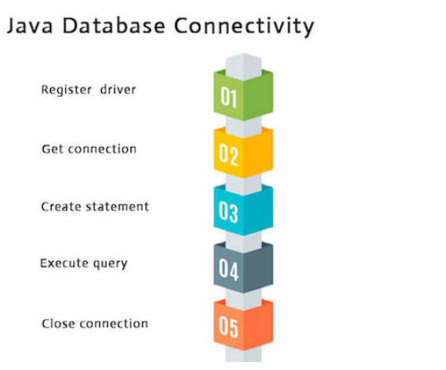
Java Database Connectivity with 5 Steps :
There are 5 steps to connect any java application with the database using JDBC. These steps are as follows:
Register the Driver class
Create connection
Create statement
Execute queries
Close connection

Slide 43
// This code is for establishing connection with MySQL
// database and retrieving data
// from db Java Database connectivity
/*
*1. import --->java.sql
*2. load and register the driver ---> com.jdbc.
*3. create connection
*4. create a statement
*5. execute the query
*6. process the results
*7. close
*/

Slide 44
import java.io.*;
import java.sql.*;
class GFG {
public static void main(String[] args) throws Exception
{
String url
= "jdbc:mysql://localhost:3306/table_name"; // table details
String username = "rootgfg"; // MySQL credentials
String password = "gfg123";
String query
= "select *from students"; // query to be run
Class.forName(
"com.mysql.cj.jdbc.Driver"); // Driver name
Connection con = DriverManager.getConnection(
url, username, password);

Slide 45
System.out.println(
"Connection Established successfully");
Statement st = con.createStatement();
ResultSet rs
= st.executeQuery(query); // Execute query
rs.next();
String name
= rs.getString("name"); // Retrieve name from db
System.out.println(name); // Print result on console
st.close(); // close statement
con.close(); // close connection
System.out.println("Connection Closed....");
}
}

